Slide 1
Cars4U
Sandhya Nair
January 2021

Slide 2
Project Objective
Obtain an overview of the data
Explore and visualize the dataset using Univariate and Bivariate analysis and identify patterns and insights.
Prepare the data for analysis
Build a linear regression model to predict the prices of used cars.Identify key variables having strong relationship with price variable
Perform tests for the assumptions of the linear regression
Evaluate the model on different performance metrics - RMSE, MAE, Adjusted R-square
Generate a set of insights and recommendations that will help the business.
Key-Questions to answer
What are the predicting variables that affect the pricing of used cars?
Does Location in which the car being sold has any effect on the price?
Does increase in kilometers_Driven decrease the price of the car?
Does Mileage ,Engine and Power has any effect on the pricing of the car?

Slide 3
Data Information
Variable | Description
S.No. | Serial Number
Name | Name of the car which includes Brand name and Model name
Location | The location in which the car is being sold or is available for purchase Cities
Year | Manufacturing year of the car
Kilometers_driven | The total kilometers driven in the car by the previous owner(s) in KM.
Fuel_Type | The type of fuel used by the car. (Petrol, Diesel, Electric, CNG, LPG)
Transmission | The type of transmission used by the car. (Automatic / Manual)
Owner | Type of ownership
Mileage | The standard mileage offered by the car company in kmpl or km/kg
Engine | The displacement volume of the engine in CC.
Power | The maximum power of the engine in bhp
Seats | The number of seats in the car
New_Price | The price of a new car of the same model in INR Lakhs.(1 Lakh = 100, 000)
Price | The price of the used car in INR Lakhs (1 Lakh = 100, 000)

Slide 4
Data Preprocessing
There are 7253 rows and 14 columns in the given data set.
Fixing the Data types
There are variables like Location, Fuel_Type,Transmission,Owner_Type,Seats that need to be converted to Category datatype
Variables like Mileage,Engine,Power,New_Price can be converted to float datatype
Dependent Variable is Price
Missing Values Treatment
The dataset has many missing values for the New_Price column. Since the new price of a car is determined and managed by OEMs (Original Equipment Manufacturer) which will not influence the used price of the car.For these reasons we have opted to remove this column
We have also calculated and removed the missing values in rows wherever applicable
Feature Engineering
Variables like Mileage ,Engine,Power has strings at the end of each value .They were removed and these columns were converted to float values

Slide 5
Data Preprocessing
Also power values having null bhp were determined and removed
Outlier determination and Treatment
We could see some outlier values in case of Mileage and Price which could affect our model so we have removed those values
Log Transformation for Kilometers_Driven variable
The Kilometers_Driven variable was highly left skewed so we have performed Log transformation on this variable to normalize it

Slide 6
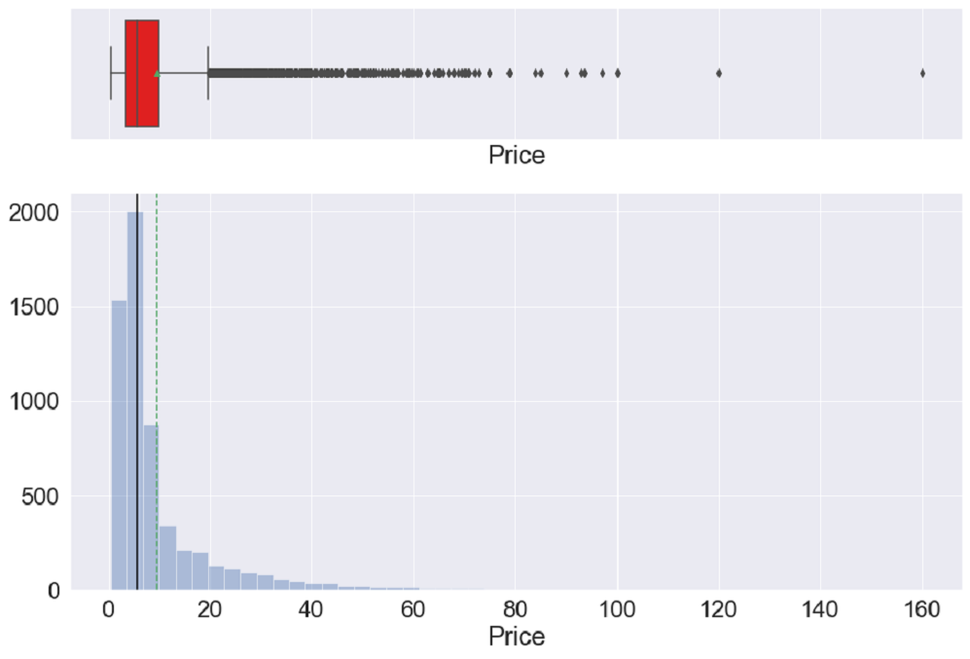
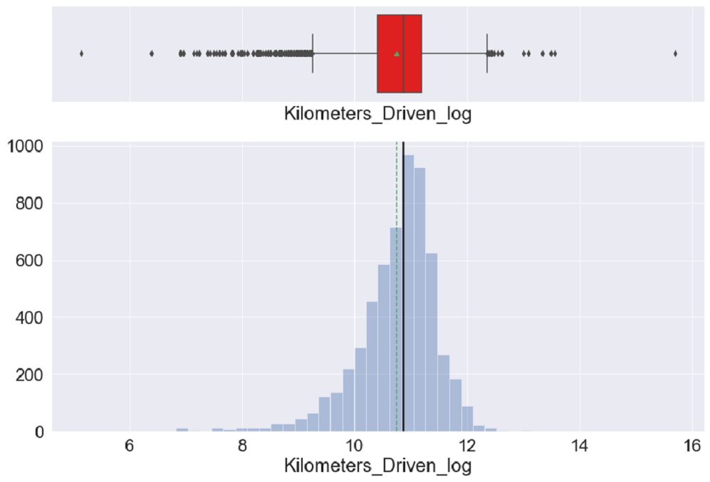
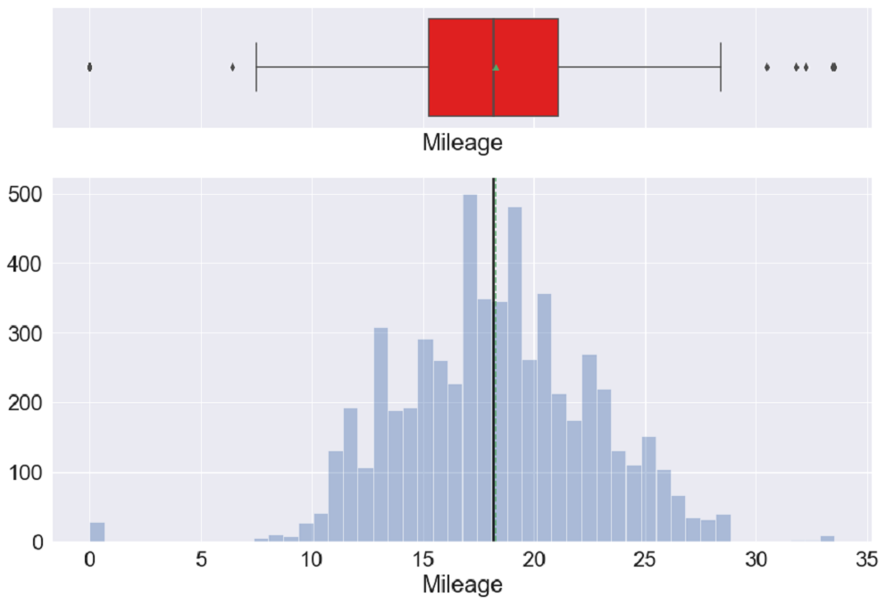
Exploratory Data Analysis-Price,Kilometers_Driven,Mileage
We can see outliers for this variable
and can see that one car specifically
priced at 160 lakhs
Most of the cars have been driven for less than 100000 Kms
We have an almost uniform distribution of data here with equal mean and median values

Slide 7
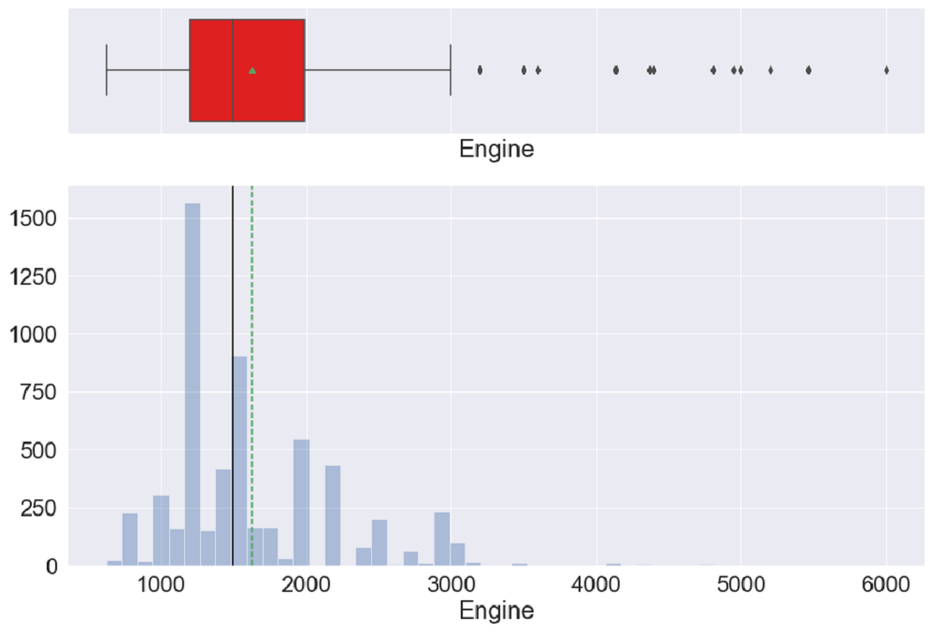
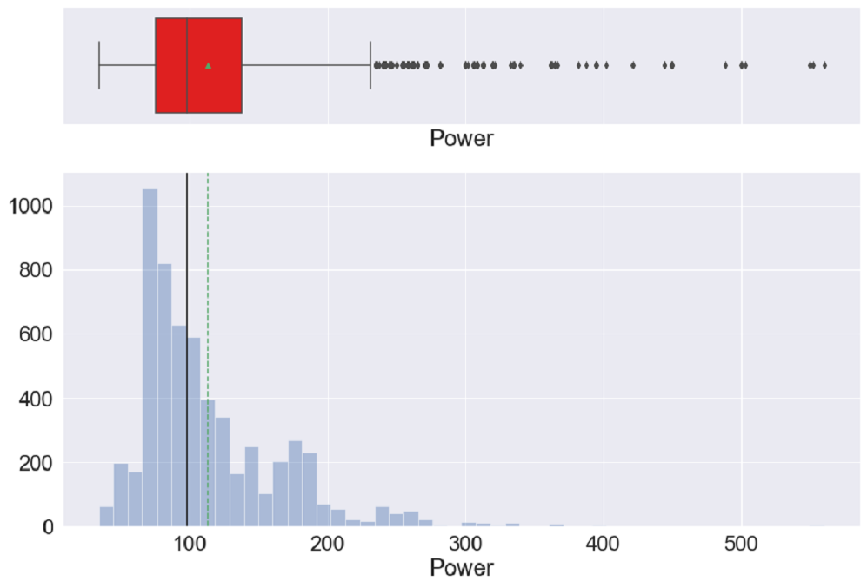
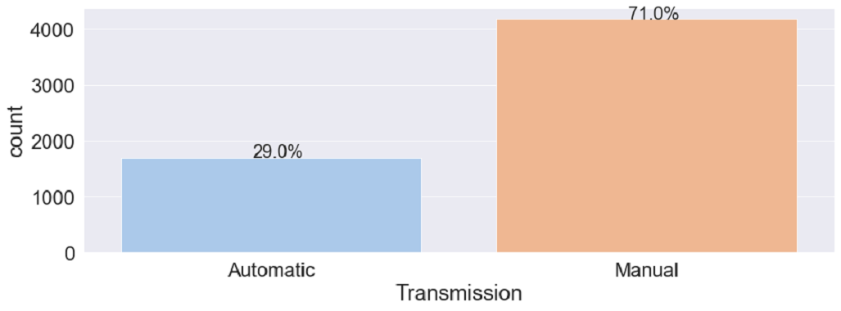
Exploratory Data Analysis-Engine,Power,Transmission
Engine Power Transmission
We can see that we have a positively
skewed distribution with
mean > median
We can see that we have a positively
skewed distribution
with mean > median
Almost 70% of the cars for sale are Manual

Slide 8
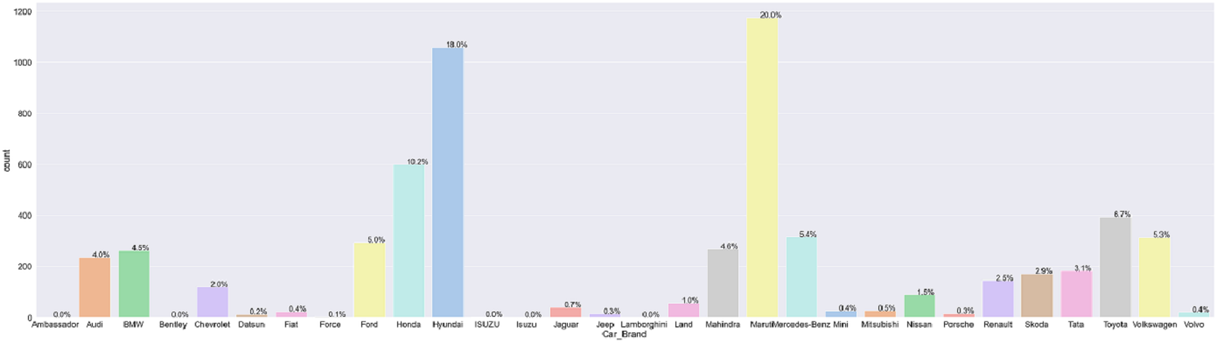
Exploratory Data Analysis Car Brand
Car Brand
Around 20% of cars available for sale are from Maruti followed by Hyundai.
Least number of cars available for sale are from Lamborghini

Slide 9
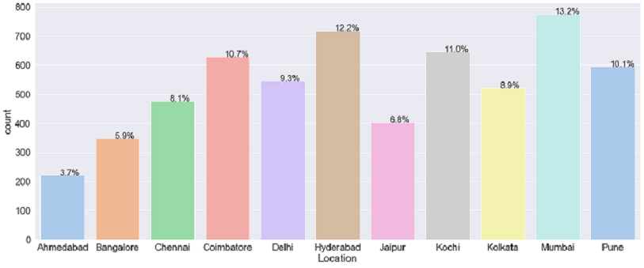
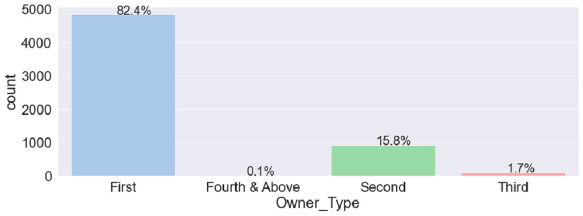
Exploratory Data Analysis Location,Owner_Type
Location Owner_Type
We can see that Mumbai has the most number of cars for sale followed by Hyderabad and Coimbatore
82.3% of cars that are for sale has an owner type of First

Slide 10
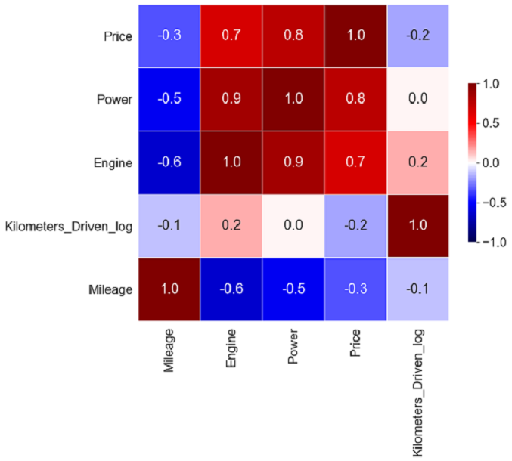
Exploratory Data Analysis-Correlation matrix
Observation:
Price is highly positively correlated with Power and
Engine which means cars with higher Power & Engine tend
to be higher priced
Price is negatively correlated with Mileage & Kilometers_Driven
meaning as the value of these variables increases Price of cars will decrease
Power and Engine has high positive correlation with each other
Power and Engine has negative correlation with Mileage

Slide 11
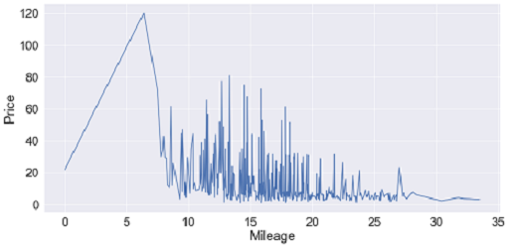
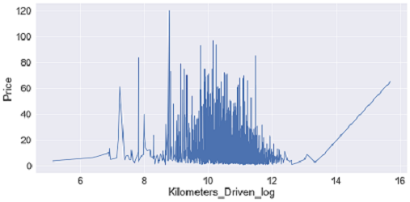
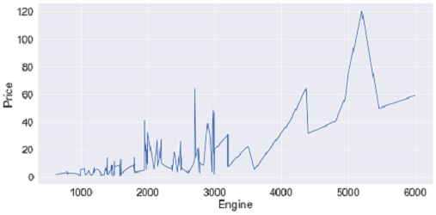
Exploratory Data Analysis Price with Mileage, Kilometers_Driven, Engine
Price vs Mileage Price vs KM_Driven Price vs Engine
Cars with lower Mileage have higher prices than ones with higher Mileage
Price decreases with more kilometers driven for the car
Engines with higher cc have higher price

Slide 12
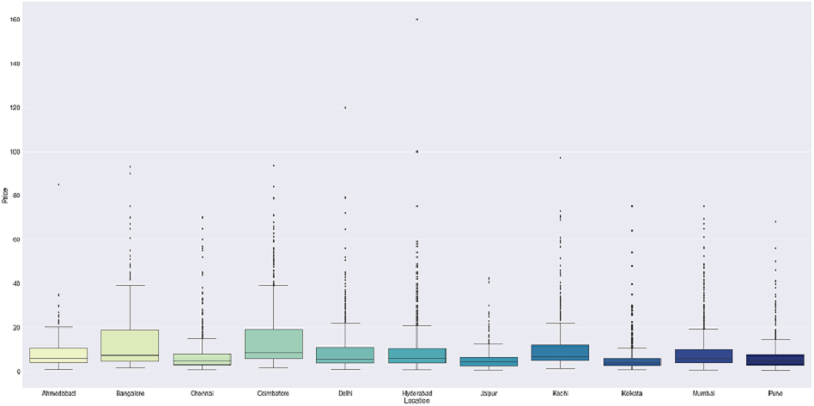
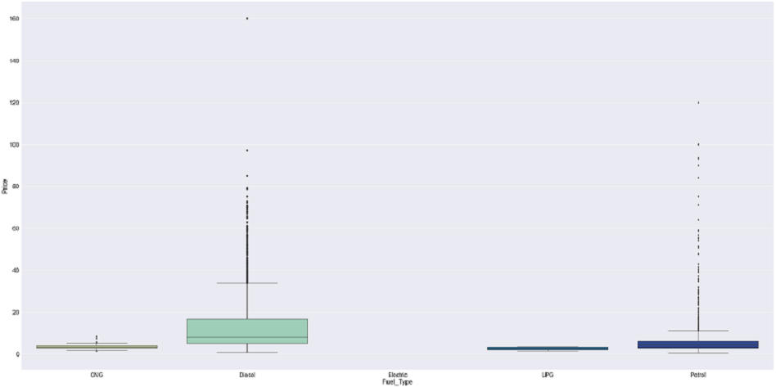
Exploratory Data Analysis Price with Location,Fuel_Type
Price vs Location Price vs Fuel Type
Cars are being sold for higher prices in cities Coimbatore,Bangalore etc. and for lesser price in cities like Jaipur,Kolkata etc.
Diesel cars have higher price among all other fuel types

Slide 13
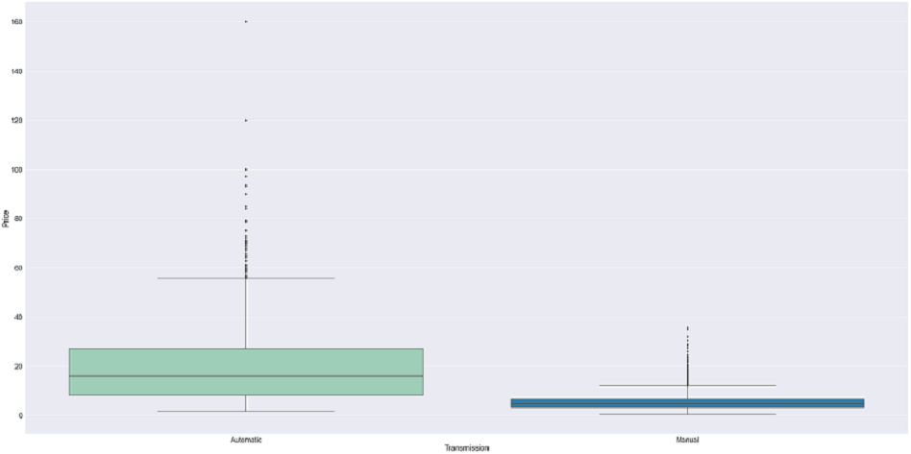
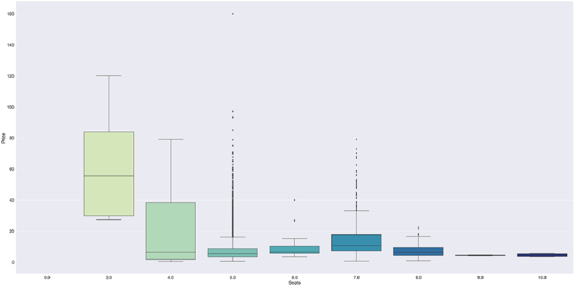
Exploratory Data Analysis Price with Transmission,Seats
Price vs Transmission Price vs Seats
Automatic cars have higher price than manual ones
Cars with 2 seats are higher priced
Cars with 5 seats are varyingly priced and those with 9 and 10 seats are priced lower

Slide 14
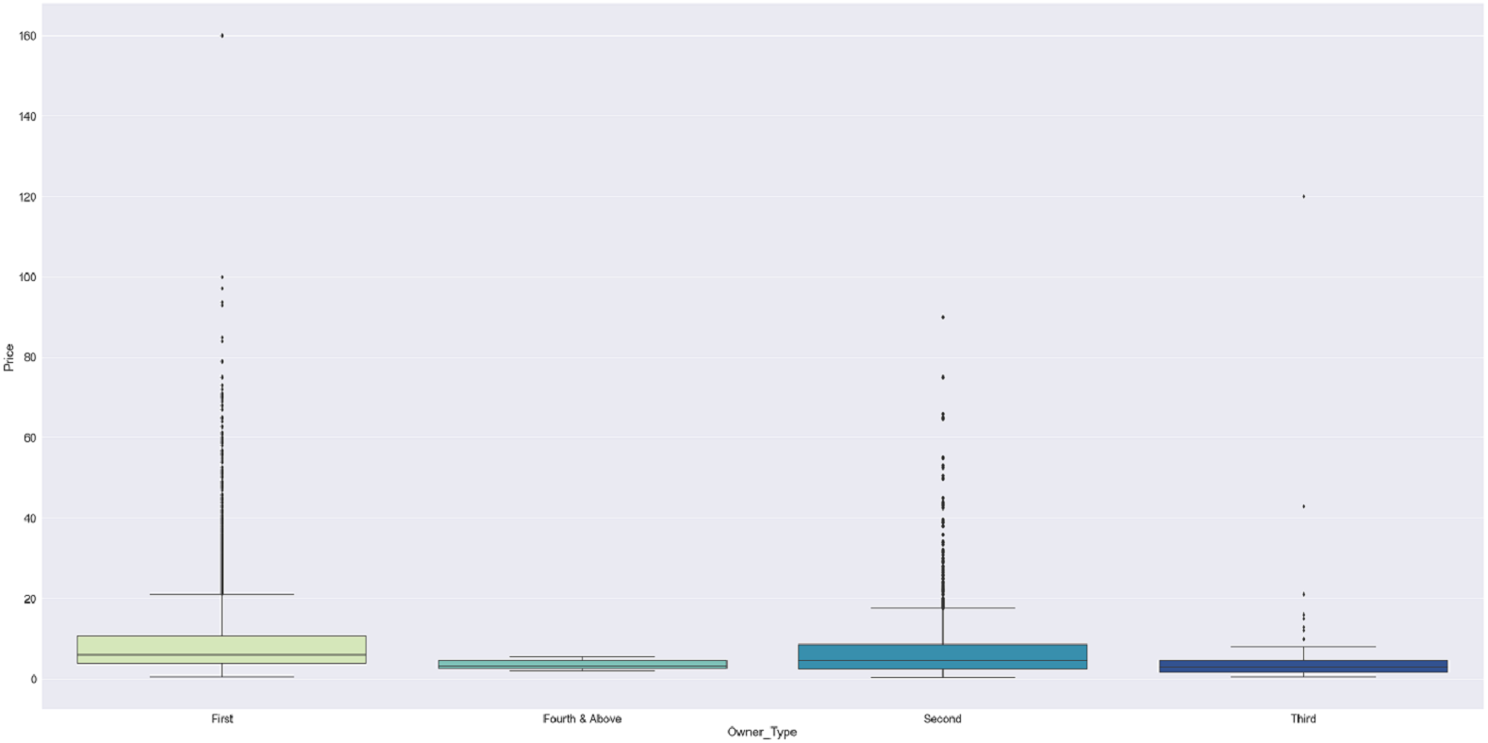
Exploratory Data Analysis Price with Owner Type
Price vs Owner_Type
First hand cars are higher priced than Second and below

Slide 15
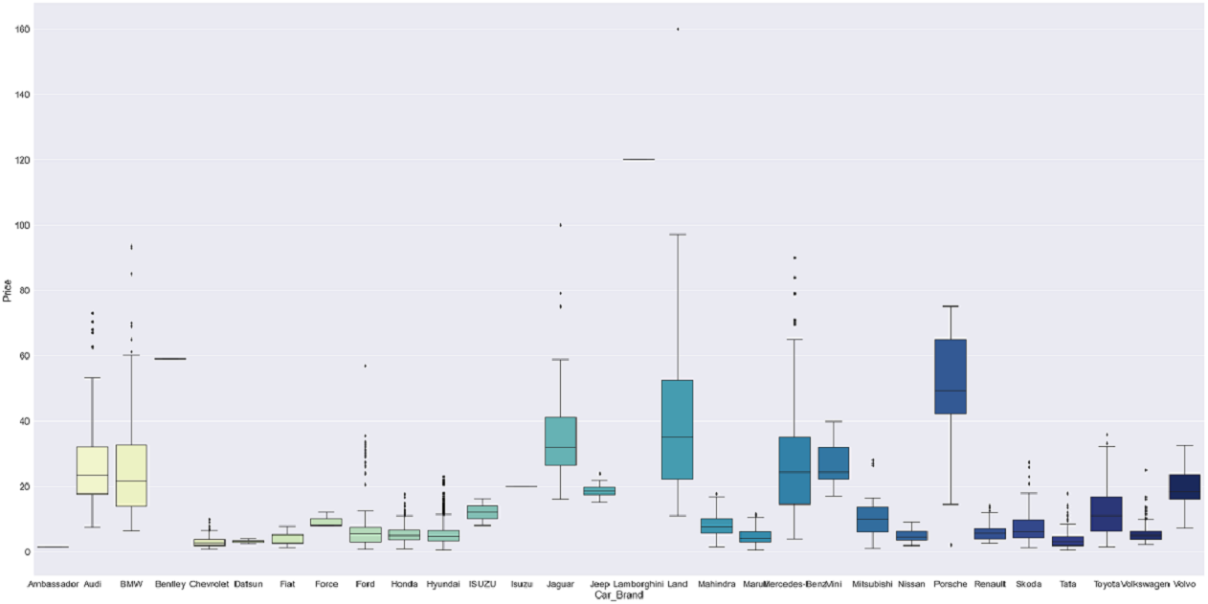
Exploratory Data Analysis Price with Car Brand
Price vs Car Brand
We can see that Land Rovers,Porsche,Audi have the highest Price among the cars

Slide 16
Insights Based on EDA
Some of the factors that increases the price of the cars are higher Power and Engine .Also prices tend to be higher for automatic cars
Cars are being sold for higher prices in cities Coimbatore,Bangalore etc. and for lesser price in cities like Jaipur,Kolkata etc.
Diesel cars have higher price among all other fuel types
First hand cars tend to be sold for more price than second and third owned
Some of the factors that decrease the price of the car are higher Mileage and higher kilometers driven
Among the cars being sold 20% are from companies like Maruti followed by Hyundai
Two seater cars are priced higher
Automatic cars are sold for higher price than manual ones
We can see that Land Rovers,Porsche,Audi have the highest Price among the cars

Slide 17
Model Building -Linear Regression
Price is the dependent variable
Below is the Model Statistics obtained after performing Linear Regression
Model Statistics
Mean Absolute Error on test:The mean absolute error (MAE) is the simplest regression error metric.It is calculated by taking the absolute value of the residual for every data point, so that negative and positive residuals do not cancel out. The average of all these residuals are then taken to obtain the MAE
Value :2.859158693523042
Root Mean Square Error:The root mean square error (RMSE) is just like the MAE, but squares the difference before summing them all instead of using the absolute value. And then takes the square root of the value.
Value: 5.135125601059347
R Squared on test: 0.796377902748143
Training Score :0.7949499732166628
Conclusion:
The Training and testing scores are around 79% and both scores are comparable, hence the model is a good fit.
R2_score is 0.79, that explains 79% of total variation in the dataset

Slide 18
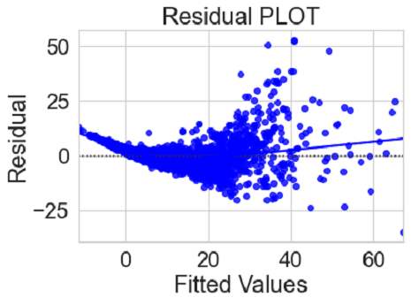
Analysis using statsmodels & Test Assumptions
Below is the Model Performance obtained after removing multicollinear variables and variables with high p-value(>0.05).
RMSE on train: 4.926335707573093
RMSE on test :5.177904758603569
Mean Absolute Error on test: 2.88091086215036
R2 Squared on test: 0.7929711447118247
Test Assumptions: we have tested the below assumptions for our linear regression model.
1. Mean of residuals should be 0. We obtained the mean of residuals
as -2.853766123167513e-13, which means it is very close to 0 in our case
2.Test for Linearity:Linearity describes a straight-line relationship
between two variables, predictor variables must have
a linear relation with the dependent variable.
Make a plot of fitted values vs Residuals, if they don’t
follow any pattern, they we say the model is linear otherwise model is showing signs of non-linearity.

Slide 19
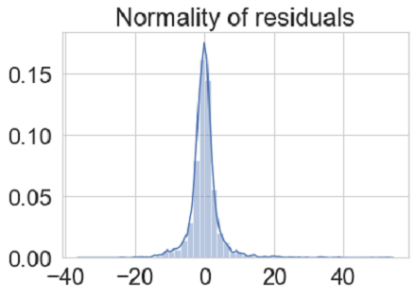
Test Assumptions
3.Test For NORMALITY:
Error terms/Residuals should be normally distributed
4.Test for HOMOSCEDASTICITY
Test -goldfeldquandt test
Homoscedacity - If the variance of the residuals are symmetrically
distributed across the regression line , then the data is said to homoscedastic.
Heteroscedacity - If the variance is unequal for the residuals across the regression line, then the data is said to be heteroscedastic. In this case the residuals can form an arrow shape or any other non symmetrical shape.
Null hypothesis : Residuals are homoscedastic
Alternate hypothesis : Residuals have hetroscedasticity
p-value obtained:0.07159340476308185, since p-value >0.5 we can say that the residuals are homoscedastic. This assumption is therefore valid in the data

Slide 20
Observations & Key variables having strong relationship with dependent variable
Mileage and Kilometers_Driven are significant variables.As these two increases, Price decreases as observed per the negative coefficient values
Also we can see that Price is negatively affected by Second_Owner type cars
Used cars that are of the Brands Chevrolet,Datsun,Honda,Mahindra,Renault Volkswagen etc tend to negatively affect the price when sold
When it comes to comes to Location, cars sold in Kolkata tend to have lower price.
Cars with higher Power can be sold for higher prices
Cars with 2,4,7,8 seats all increases the price of the cars
In terms of Location cars sold in Bangalore,Coimbatore,Chennai,Hyderabad etc tend to be sold for higher prices
Also the price increases for Diesel cars
Cars like BMW,Bentley,Jaguar,Land,Mercedes Benz,Porche,Mini cooper ,Toyota,Volvo tend to positively affect the price

Slide 21
Actionable Insights & Recommendations
Based on the Analysis and Model output,below are some of the recommendations to grow the business
As we saw from the analysis , Mileage and Kilometers_Driven negatively impact the Price, so when buying cars for sale, need to make sure Mileage is less meaning less wear and tear for the car.
Also buy cars for sale with less kilometers driven in them.
Since Power is positively influencing price ,cars with higher power can be sold for better price.
The best locations to concentrate for business would be Bangalore,Coimbatore,Chennai,Hyderabad etc.
Buying more Diesel cars for sale would be more benefitable since they tend to be sold for higher price.
In terms of Car Brands , buying more cars like BMW, Bentley,Jaguar,Land,Mercedes Benz,Porche,Mini cooper ,Toyota,Volvo will also be benefitable since they tend to be sold for higher price

